Slide 1

Audio Feedback for eportfolio activities
Judith Lane
Programme Leader
MSc (pre-registration) Physiotherapy
School of Health Sciences
Queen Margaret University

Slide 2
Principles of feedback (Draper, 2007)
helps clarify what good performance is (goals, criteria, expected standards);
facilitates the development of self-assessment (reflection) in learning;
delivers high quality information to students about their learning;
encourages teacher and peer dialogue around learning;
encourages positive motivational beliefs and self-esteem;
provides opportunities to close the gap between current and desired performance;
provides information to teachers that can be used to help shape the teaching.
Notes:
The aim of the audio feedback was to try to address some of the principles of good feedback.

Slide 3
Why is it worth considering different ways of giving feedback?
Notes:
The results of our student survey indicated that students did not necessarily feel that our feedback was fulfilling all the princples of good feedback and therefore there was a need to address our feedback.

Slide 4
Assessments
Write 1500 words which critically reflect upon two of the learning objectives that you set for your foundation placement. You should consider to what extent you achieved these objectives and how you achieved them, providing evidence to support your arguments. You should also consider how you will assimilate this learning into your further practice based learning placements.
Write a 1,000 word webfolio which contains a formative reflective account of your learning across placement 1 & 2 concluding with a justified bulleted list of learning needs
Notes:
I chose two assessments which are submitted via the eportfolio gateway as a pilot for audio feedback. These assignment are reflective and build upon each other. The first is undertaken at the end of semester 1 in first year, the second is undertaken at the end of year 1 and both contribute the development of a professional portfolio. Reflective assignments are very difficult to give useful written feedback for whilst sticking to the subject area policy of three short written comments. Therefore I felt that audio might be a useful approach.

Slide 5
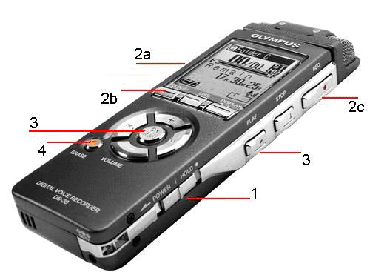
How did we do it?
Digital recorder
Dictate feedback whilst reading the eportfolio assignment on the computer screen
Attached to webfolio as a ‘comment’
Notes:
There are several ways of delivering audio feedback. Recording provides the most flexible method and of course provides a permanent record which is necessary for external review. In this case we chose to replace, written individual feedback with a personalised tutor monologue which focused on the individual assessment criteria. There are many methods recording your voice for audio feedback. Although I am not a complete luddite, I don’t posses the hardware for complicated methods of recording. Therefore I opted for the most simple method which was to use a digital voice recorder. Here however I must sound a note of caution. Some digital voice recorders do not record in either .wma or .mp3 format – they have their own file type. This can make it difficult to play back so make sure that digital recorder uses an appropriate file type before starting your recording!
Other than that, the process was really easy. Te file is uploaded to the eportfolio in the same way that any other file is added.

Slide 6
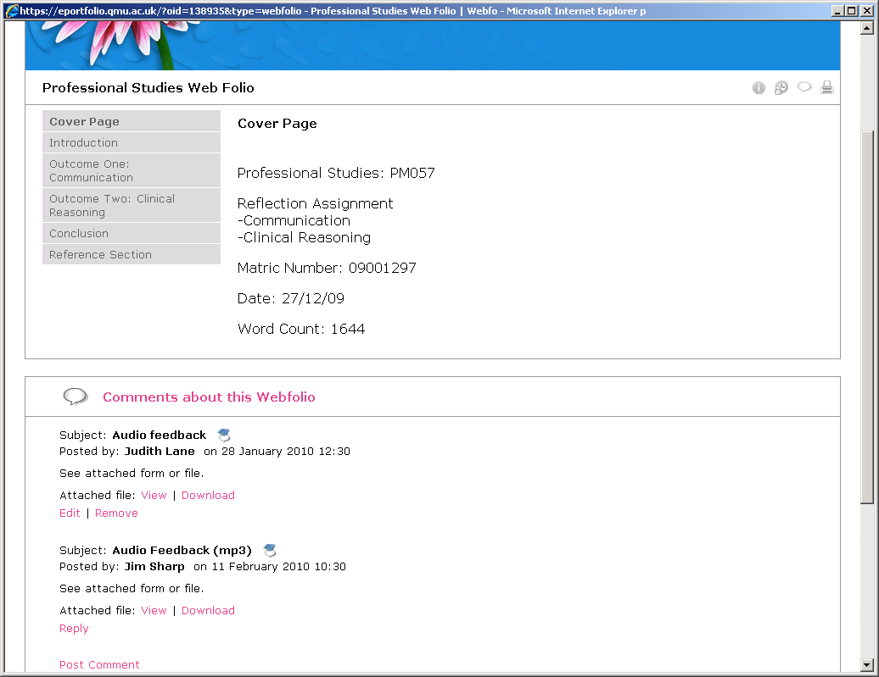
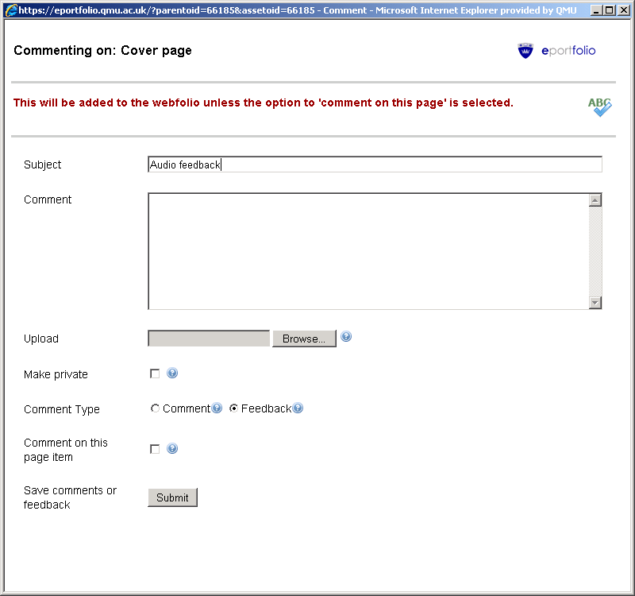
Notes:
You can see here that the file was uploaded to the webfolio as a comment and then the student could download it.

Slide 7
Expectations
“Thought it was an interesting idea, but didn’t want to listen to mine – felt too personal”
“I thought it had the potential to be a good alternative to written. I thought it would be a staff member reading off a feedback sheet”
“Thought it could be a bit daunting, especially if it was going to be bad”
Notes:
Following the two pilots, students were invited to give their opinions on the audio feedback to a member of staff from the centre for academic practice. They were asked questions relating to their expectations of the feedback and their opinions on it now.
Many students said that when they learnt that the feedback would be audio, they were interested to see what it would be like. Many commented on the fact that they thought it would be personal. As you can see this was not always perceived to be a positive aspect. It was interesting that some students felt more nervous about the thought of audio feedback.

Slide 8
What do you think about it now?
“I liked having the feedback. I found it gave individual specific areas which could be worked on. Individual advice on personal level”
“I thought it was good and more personal than I expected. Also it was easier to follow and understand the points being made than if it was written down”
“Really like it, was much better feedback and more constructive than the usual written comments”
Example 1
Example 2
Notes:
When asked generally what they thought of the feedback once they had received it, 11 of the 20 students were very positive. The personal aspect was highlighted as being positive. The constructive nature of the feedback was also commented upon.

Slide 9
What do you think of it now?
“Wasn’t as personal as I thought it might have been, but would still have preferred informal written feedback (i.e. the transcript)”
“Good, provided more information than written. However if the same information was written it would have been no more beneficial”
“I thought it was good in that feedback was more broad and brought up pros and cons in more detail. This could have been written though”
Notes:
Not everyone was overwhelmingly positive however. A number of students were non-committal – 5 our of the 20 did not feel that it offered much more than written feedback but were happy enough to have received it in audio format.
Interestingly they felt that the text could have been written – what they didn’t appreciate was that the we would never write as much as we could say – it is too time consuming to write that much text.

Slide 10
What do you think of it now?
“Interesting, very personal but I don’t really like it”
“I prefer written feedback however the content in audio was more in-depth…”
“Seem a waste of tutors time”
“I listened to it only once and didn’t want to go back whereas the written one. I’d go back to it”
Notes:
Only 4 our of the 20 students expressed either a dislike for the audio or a preference for written. It was not clear why those who said that they didn’t like it felt that way.

Slide 11
Advantages
Volume
More detail
Greater quantity
Personalised
Comments more personal
More time spent on you
Intonation
Hearing tone of voice makes interpretation easier
Notes:
When asked what the advantages of audio feedback might be for them, the main themes that arose was the volume, the personalised nature and the ability to interpret the meaning and context behind the comments.
Comments relating to the more personal aspect of the feedback indicated that the students felt that the tutor had spent more time on them. In reality this might not have actually been the case but the perception of having spent more time may have improved the motivational benefits that are characteristic of good feedback.

Slide 12
Disadvantages
Review
Harder to go back to specific points
Can’t print it off
Learning style
More difficult for ‘visual learners’
Technical difficulties
Sound quality not always good
Didn’t always work on home computers
Notes:
The disadvantages cited were relevant. It is harder to go back to specific points in the feedback without playing the whole thing through. Students didn’t like the fact that they could not obtain a hard copy of this feedback – there seems to be some greater validity in the minds of students about hard copy feedback.
Comments relating to learning style were interesting. Some students felt that audio feedback did not fit well with their visual learning style. I’m not sure I entirely accept this argument as they will experience a wide range of learning experiences which include both visual and auditory. University teaching provides a strong focus on auditory learning and I have never had students complain about this before. However the argument does simply reinforce my belief that a range of experiences are necessary in order to benefit all students and thus for me this is an added benefit of audio feedback.

Slide 13
Would you recommend audio feedback to others?
Notes:
Overall the majority of students felt that they would recommend audio feedback to others. This was primarily because of the quantity and depth of the feedback contained within. Many were clearly a bit uncomfortable with not having a ‘hard copy’ of the feedback but the quality of the feedback overall was improved.
From a staff point of view, the feedback can be attached directly to student work linking the working and the feedback much better. Although the personal nature of the feedback can feel daunting to the student, if care is taken to ensure that positive and constructive feedback is given, the potential for the feedback to act as a motivator and to foster self-esteem is huge.

Slide 14
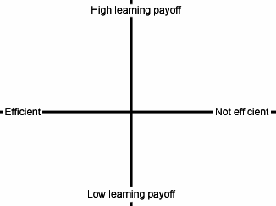
Summary
More extensive written feedback
Audio feedback
Current written feedback policy
No feedback
Notes:
In summary I feel that the audio feedback offered a much higher learning payoff without losing efficiencies. A similar level of learning payoff could probably be achieved through more extensive written feedback but with definite losses in terms of staff efficiency.

Slide 15
References
Draper,S.W. (2007, May 8) Seven principles of good feedback practice[WWW document]. URL http://www.psy.gla.ac.uk/~steve/rap/nicol7.html (visited 2010 Sept 6)

