Slide 1
Dr Roni Bamber, Queen Margaret University, Edinburgh http://www.qmu.ac.uk
Principles and practices of good university governance
Notes:
Will draw on recent consultation docs on University Governance in Scotland

Slide 2
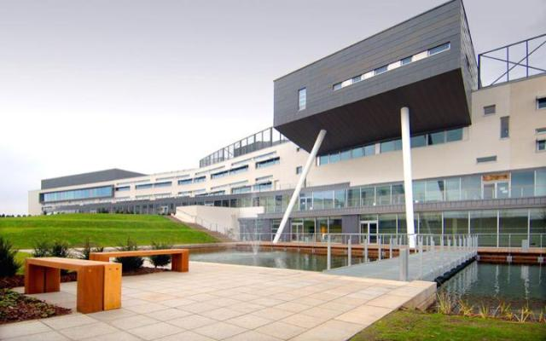
Queen Margaret University
Notes:
New campus 2007 (eg of NEW quality issue – comms). Subjects. Mission.

Slide 3
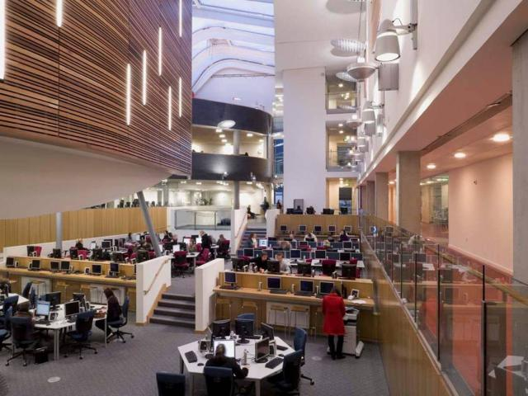

Slide 4
Aims of Session
To offer some ideas on structures for good governance
To provide examples of what those ideas look like in practice

Slide 5
Purpose of good governance
‘to ensure that institutions are effectively and responsibly managed in pursuit of long-term strategic objectives consistent with their missions and goals’ (Universities Scotland, 2011)

Slide 6
External Governance -Conditions of Funding (Council)
Eg
‘the institution is actively engaged in seeking continuously to enhance the quality of its programmes and services and to involve students and other stakeholders in these processes’
‘there are in place up-to-date and readily accessible procedures for handling complaints by students, staff and others’
‘the institution’s activities are conducted in an appropriately open, transparent and fully accountable manner’
Notes:
QAA codes of practice http://www.qaa.ac.uk/AssuringStandardsAndQuality/code-of-practice/Pages/default.aspx

Slide 7
Reporting: UK HEIs
More than 550 external lines of reporting in sector!
Engaged with 130+ professional, statutory or regulatory bodies (PSRBs)
For professional accreditation (Universities Scotland, 2011)
SO: Importance of good data gathering and reporting mechanisms

Slide 8
Elements of governance
Management of the University
Structures: committees + departments
Staff voice
Student voice

Slide 9
1 Management of the University

Slide 10
Management within ‘Responsible Autonomy’
Across Europe
Move towards responsible autonomy
Away from direct / indirect government control (Aghion et al, 2009)

Slide 11
How? Strategic Dialogue
Resources, Directives, Requirements
Funding Council
(Government)
Institutional Management
Governing Body
(Court)
Runs the University
Oversees Strategy

Slide 12

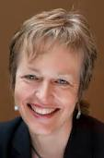
Who’s steering?
Government: navigation requirements
Court: oversight of route
Principal: Captain

Slide 13
Keeping staff & students informed of progress along the route
“TO ALL MEMBERS OF STAFF AND STUDENTS’ UNION EXECUTIVE
Dear Colleagues
WHERE WE ARE NOW - Recent Progress at QMU and Next Steps
A Presentation by the Principal – Tuesday 15 May at 11.15”

Slide 14
“I am writing to invite you to attend the next ‘Where we are Now’ presentation. At this event, I will cover:
· Update on strategic planning & realisation of vision
· Recent successes across the University
· Key statistics
· Financial performance
· Future priorities
You will also have the opportunity to ask questions.
I look forward to seeing as many of you as possible on the day..
Petra”

Slide 15
Governing Body (Court)
Responsible for setting institutional strategy
On recommendations of institutional management
Oversees implementation of strategy by institutional management
Responsible for use of public funds
Expected to listen to stakeholders

Slide 16
Governing Body - Court
Mix of lay members (60%), staff & students (30%), senior managers (9%)
Small enough to act quickly
Large enough to have wide range of experience and skills
QMU Court
Notes:
Approx %s

Slide 17
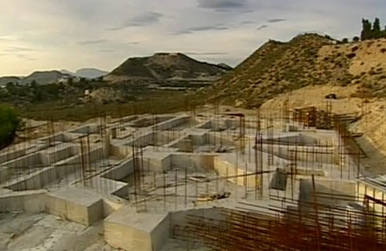
2 Which structures need to be in place to support good governance?

Slide 18
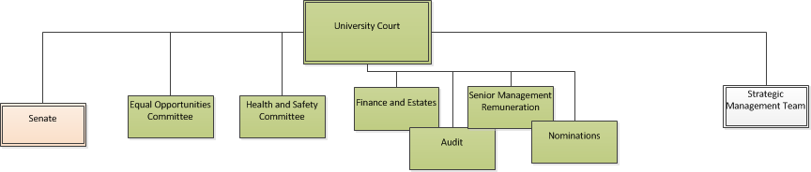
QMU Governance

Slide 19
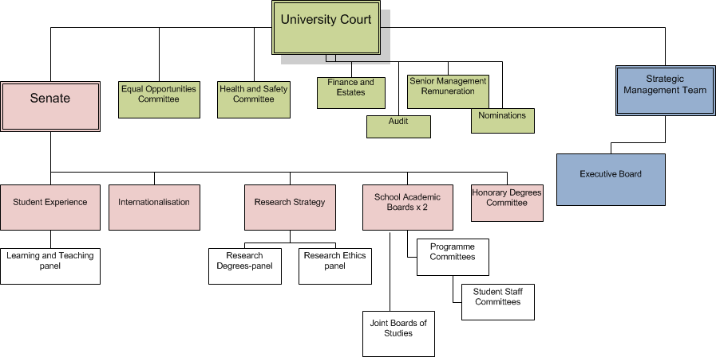
QMU Committee Structure

Slide 20

Strategic Committee Structuring
Where possible:
Plug and socket = University and faculty / school
Eg Quality Committee in University
Quality Committee in Faculty
Faculty reps on University Cttee

Slide 21

Structure – Professional Services
Quality Enhancement:
Centre for Academic Practice
Quality processes:
Quality Unit
Close working relationship

Slide 22
What roles do staff and students play in the governance of universities?

Slide 23
3 Staff and Good Governance

Slide 24
Staff Voice
Senate
Authority on academic matters
Represents entire (internal) academic community
Key role in academic governance
Collegial decision-making
Working groups and consultations
Eg Review of QMU Strategy
Eg Review of Annual Monitoring

Slide 25
Staff and Quality Review
Internal review:
Programme approval members + chairs
(External) institutional review:
Programme approval members
Review of other institutions:
Programme approval members

Slide 26

Staff + Role of Structured CPD (Continuing Professional Development)

Slide 27
CPD
National requirements & recognition (eg HEA Fellowship)
PG Cert in L&T as probationary requirement
Not just new academics
Changing needs of experienced staff
Part-time staff
PhD tutors
Learning support staff

Slide 28
At QMU: L&T Development
PG Cert in Professional and Higher Education
Education in Action; Curriculum Development; Technology-enhanced Learning; Researcher Development
Short Course
5 days: Lecturers, PhD tutors, Overseas partners
Workshop programme
Programme Team provision

Slide 29

4 Students and Good Governance

Slide 30
Scottish Funding Council’s expectation that...
‘students would be involved in all processes relating to quality assurance and enhancement and that students should be represented as widely as possible in each institution’s consultative and decision-making forums’

Slide 31

Meaning of student engagement has expanded
Not just them giving feedback on their learning experience
Full involvement in university quality and decision-making processes
And in national quality and decision-making processes (eg sparqs)

Slide 32

Aim: students as ‘active partners’ in HE
Eg national projects: http://www.heacademy.ac.uk/student-engagement
And institutional codes of practice. Eg http://www.gla.ac.uk/media/media_107529_en.pdf

Slide 33
Student Voice – at QMU
Feedback and Evaluation:
Representation of student views (Programme Management)
Class reps, Programme reps
Student Staff Liaison Committees
Student Union, Student Parliament
Individual feedback on learning and teaching
Module evaluation; Programme evaluation; NSS; Themed evaluation – eg on Induction

Slide 34
Student Voice - Representation
Class Reps
Students on
all university committees
all programme approval panels
Senior mgt – Student Union meetings
Student-Led Teaching Awards
Students as Reviewers
On Review Panels within the University
On QAA Review Panels
Notes:
Exeter Univ: student on all appointment panels for academic staff

Slide 35
References
Aghion et al (2009) The governance and performance of research universities: evidence from Europe and the US . Working Paper 14851 . Cambridge. http://www.nber.org/papers/w14851
Committee of University Chairs (CUD) (2009) Governance Code of Practice and General Principles. HEFCE) http://www.hefce.ac.uk/pubs/hefce/2009/09_02/
HEFCE (2011) Leadership, governance and management http://www.hefce.ac.uk/lgm/
Schofiled, A (2009) What is an effective and high performing governing body in UK Higher Education? Pp 9-15 . LFHE & CUC. http://www.lfhe.ac.uk/governance/reviewinggovernance/schofield-effgb.pdf
UK Combined Code on Corporate Governance (2010) http://frc.org.uk/corporate/ukcgcode.cfm
Universities Scotland (2011) Review of Higher Education Governance. Edinburgh: Universities Scotland

Slide 36



Further reading: quality issues in my research
Notes:
Book 1 – change mgt in enhancing quality
2 – evidencing and evaluating quality
3 – changing nature of ac work, and how ac staff deal with issues like quality

