Slide 1
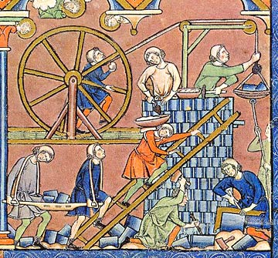
Tribes, Territories and Tribal Reservations
Dr Roni Bamber
Queen Margaret University, Edinburgh
vbamber@qmu.ac.uk

Slide 2

Trowler, Saunders and Bamber (Eds) (2012)
Tribes and territories in the 21st-century: Rethinking the significance of disciplines in higher education

Slide 3


The others...

Slide 4
What will I cover?
Updated notion of Tribes and Territories
Some examples from different disciplines
The Social Practice Theory perspective on this
Questions about
The value of metaphor
What is changing in your ‘tribe’

Slide 5
Literature to support strength of epistemologies in disciplines
Biglan (1973) - epistemological paradigms
Neumann (2002) – Biglan’s paradigms mapped onto L&T dimensions
Lattuca and Stark (1994) [Biglan again] - ‘unequivocal’ patterns in knowledge conceptions and practices
Altho all recognised complexity

Slide 6
But now more nuanced
Epistemology only part of the mix. Eg
Signature pedagogies (Shulman, 2005)
Ways of Thinking and Practising (McCune and Hounsell, 2005)
Threshold concepts (Meyer and Land, 2003)
Mix of influences in identities (Henkel, 2000)
Context and personal ideology (Fanghanel, 2009)
Teaching and Learning Regimes (Trowler and Cooper, 2002)
Shifting disciplinary boundaries (Malcolm and Zucas, 2009)

Slide 7
Argument of the book
Epistemological essentialism doesn’t reflect the dynamic, complex nature of HE work
Barnett (2000) – supercomplexity
academics work together in ‘epistemological pandemonium’
But that pandemonium has patterns, key features
From SPT perspective
Intellectual territory of the discipline (epistemology)
academic identities, discourse, multiple cultural configurations, social context

Slide 8
Because...
Academics not in an inflexible disciplinary framework
They’re constantly reworking disciplinary norms
Recreating what they do, and how
Individuals both construct and enact culture
Not passive recipients
Key = changing nature of disciplines over time
And constant influence of other, non-epistemological, factors

Slide 9
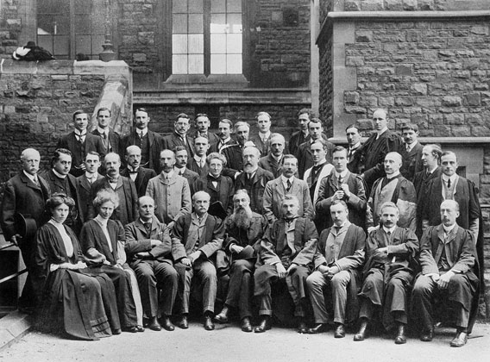
So: Disciplinary knowledge systems
fluid, dynamic and constantly nudged by non-disciplinary policies, initiatives and HE trajectories
Importance of context

Slide 10
Four Tribes for 21C
Ashwin et al (Sociology)
kinds of knowledge produced, who has access to these different kinds of knowledge, and how different groups in society gain access to particular kinds of knowledge
Winberg (Engineering)
ways in which L&T conducted in engineering
relationship between academic knowledge and professional knowledge
knowledge claims between and across fields, along epistemic and social axes

Slide 11
2 Engineering (ctd)
Academic world:
the epistemic relation (eg knowledge of mathematics or physics) is dominant
In professional practice
social relation (eg interpersonal communication, or the ability to mediate technical information for particular clients) comes to the fore
Different attribution of value to L&T activities in each ‘world’
Eg dissent over nature of student projects + simulation of real world practices

Slide 12
Raises questions about...
Identity of engineering academics
Engineers, academics, strange mix of both?
Identity of ‘engineering’
fragmented identities visible between engineering academics with different specialisations

Slide 13
Changes over time
3 Laiho (Nursing Science)
what makes a discipline what it is, and how its place in universities mutates over time in response to a number of influences
4 Kleiman (Performing Arts)
Problematises ‘performing arts’ (= dance + music + drama)
How trajectories of subjects over time has shaped their place in HE, and identities of academics involved

Slide 14
4 Nursing - Changes to disciplines over time: dimensions
Knowledge base; eg academic base v clinical practice
Chronologically, over time: maturity of discipline
Status of discipline: legitimacy as academic subject
Geographically: where different nursing specialisms taught
In practices: eg presence or not of research
Agents of discipline: eg are there professors? Shifting identities
Intersections / permeable boundaries
Links to other disciplines
Academic / professional work and discourses
Disciplinary profile: international, national or local
Other dimensions you can think of?

Slide 15
From SPT perspective: Identity
Academic identities = fluid, dynamic, reconstructing
Di Napoli and Barnett (2008: 4): current HE = ‘a site of many identities-in-the-making’
Eg Kleiman ‘landscape of the [different] disciplines and their various interlocking and interconnecting communities of practice consists of a complex, multi-faceted, multi-layered network of identities, relationships, values, discourses and practices’.
This leads to ‘the adoption of multiple, metamorphosing identities within the discipline’
Example of pt artist / academic

Slide 16
SPT: Discourse
Expresses and shapes social reality and practices
How to help students enter our disciplinary world?
Help them build discourses (Shreeve, 2009; Kapp and Bangeni, 2009)
Help them work between practice and academic contexts (Baxter Magolda, 2008)

Slide 17
SPT: Multiple cultural configurations
Vertically, single disciplines have different manifestations in different institutions
Boundary-crossing (Tuomi-Gröhn et al, 2003)
Horizontally, subject groupings within institutions
Externally, academic + professional worlds
People in universities interact in their various locations, producing different sets of social practices and cultural configurations in each locale

Slide 18
SPT: Social context
Tribes and territories notion assumes a semi-universal experience, regardless of institution
But contextual factors influence what goes on in any particular location
Eg elite v non-elite institutions (Ashwin et al)

Slide 19
When is value of ‘tribes’ concept most helpful?
Analysis of identity gaps
between subject groups
Eg Laiho’s Nursing lecturers aren’t Physios or other allied health specialists
between what academics do, and what students do
Eg Ashwin et al re Sociology
Analysis of identity ‘drift’
Eg Kleiman re academics focusing on generic skills / employability agendas
Battle ??? For Political identity
Eg the fight for arts and humanities

Slide 20
2 Qs for you
1 What factors make your ‘tribe’ what it is?
2 What is affecting / changing this?

Slide 21
The power of metaphor
‘Tribes’ and ‘Territories’
‘Roots’
‘DNA’ (Kleiman)
Your alternative metaphors?

Slide 22
Factors in complexity of Territories
Eg Policy initiatives (enterprise, employability, modular programmes, credit accumulation)

Slide 23
References

